Slide 1
An Automated Approach: Re-engineering and Refactoring Legacy Systems
Farouq Haider 20P-0091
Adda Hussain Qazi 20P-0488 Aabideen 20P-0006

Slide 2
Table of contents
01
02
03
04
05
06
Introduction
What is Refactoring?
Tools of the Trade
Challenges
Solution
Conclusion

Slide 3
Introduction

Slide 4
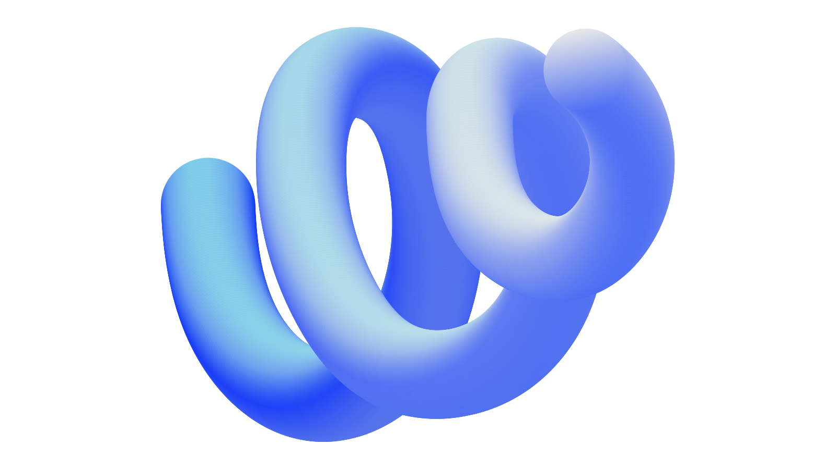
Software Systems continually evolve

Slide 5

Adapting software to new needs is tough and time-consuming
Manual efforts are expensive and risky

Slide 6
Automated Refactoring at Scale

Slide 7
What is Refactoring?

Slide 8
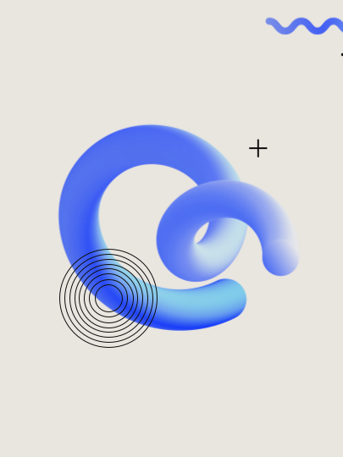
Floss Refactoring
Root Canal Refactoring
I.e refactoring to improve a
metric or remove a code smell

Slide 9
This work doesn’t necessarily provide consistent system-level restructuring

Slide 10
Refactoring at Scale?
refactoring at scale as restructuring software for a system-specific business goal.
(to support system evolution)
Functional + Architectural Change

Slide 11
Tools of the Trade

Slide 12
SonarQube
Lattix
Bugs
Security
Vulnerability
Code Smells
Architecture Analysis
Large-Scale Softwares
Structural Dependency
Codebase Optimization
Understand
NDepend
Metric Generation
Flow Graph
Code Navigation
Code Metrics
Code Dependency
Improve Quality
Improve Maintainability

Slide 13
Have high noise and false alarm rate.
Why?

Slide 14
Identify structural couplings and generate warnings based on metrics and heuristic thresholds
But do not assess how changes can impact a specific objective.

Slide 15
Frame refactoring selection
as an optimization problem

Slide 16
Challenges

Slide 17
Automation scope
Choosing solutions
Representations
Balancing theory and practice
Adaptability.
Workflow changes

Slide 18
Solution

Slide 19

Feature Isolation
“Developing an approach to specify the feature that a developer would like to isolate”

Slide 20
Feature isolation is the process of separating specific features within a software system from the rest of the codebase. This separation enhances modularity, making the code more maintainable and adaptable, a goal often achieved through refactoring.

Slide 21
Common industry scenarios
Breaks down monolithic systems into microservices
Extracts reusable features from codebases
Replacing a feature with an improved or less proprietary option

Slide 22
Achieving Feature Isolation: Our Approach

Slide 23
Developing an approach to specify the feature that a developer would like to isolate
Creating a viable representation
Creating a catalog of formalized refactorings
Developing a refactoring recommendation engine by applying search-based software engineering

Slide 24
Visualization of Feature Isolation Progress through Refactoring

Slide 25
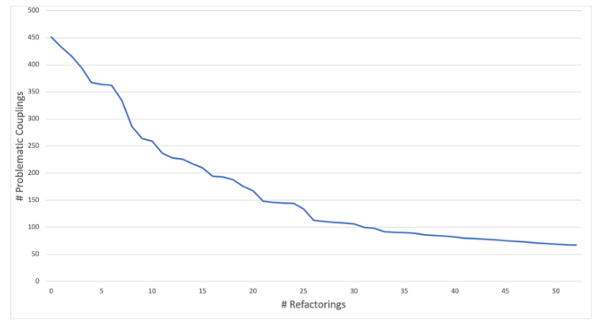
Reducing problematic couplings by applying refactorings

Slide 26
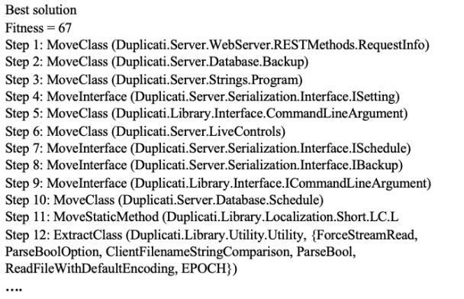

By applying refactorings such as Extract Class or Extract Interface, developers can effectively break down large, tightly coupled components into smaller, more modular ones

Slide 27

Thanks!

